Slide 1

Advanced Control Implementations with Modelica
FMH606 Master’s Thesis 2023 Industrial IT and Automation
Carl Magnus Bøe

Slide 2
Hva skal fortelles
Hva er situasjon nå
Hva ønsker man å endre
Hva finnes I markedet
Implementert modell
AIR HEATER
Different methods of calling external C I Modelica
Results and comparison
Calling NLopt
Results and comparison
FMU PID
Results and comparison
FMU MPC
Results and comparison

Slide 3
Introduction
Background information
Modelica
FMU
SIMULINK
Model Predictive Control Toolbox
Modelica
External Object

Slide 4
Introduction
Revised scope
Modelica
External Object
Modelica
External Object
FMU
Python

Slide 5
Introduction
Modelica
Equation-Based Modeling:
Modelica uses equations for dynamic system representation
Multi-Domain Support:
Models complex systems across diverse engineering domains
FMUs for Interoperability:
Supports Functional Mock-up Units for model exchange and co-simulation
Declarative Approach:
Defines variable relationships without specifying solution algorithms
Graphical and Textual Options:
Offers flexibility with both graphical and textual modeling
Notes:
Equation-Based Modeling:
Modelica uses equations to describe system behavior, allowing for a natural representation of dynamic systems.
Multi-Domain Support:
It's designed to model complex systems across diverse engineering domains like electrical, mechanical, thermal, and fluid systems.
Functional Mock-up Units (FMUs):
Modelica supports FMUs, enabling model exchange and co-simulation with other tools, enhancing interoperability and collaboration.
Declarative Modeling:
The language takes a declarative approach, focusing on defining relationships between variables rather than specifying solution algorithms.
Graphical and Textual Options:
Users can choose between graphical and textual modeling, providing flexibility in creating and editing models to suit individual preferences and project needs.

Slide 6
Existing Options
Linear MPC Modelica Library
JModelica
Open-source
Last updated 2016
Not compatible with Modelica 4.0
Discontinued in 2019
Assimulo
PyFMI
FMI Library
FMPy - Dassault Systèmes
NLopt
Free Python FMU library
Graphical user interface
Validate FMUs
Export to Jupyter Notebook, Modelica and Cmake
Web App
Open-source optimization library
C, C++, MATLAB, Fortran, Python among others
Collection of several algorithms from different contributors
Notes:
Linear MPC Modelica Library
State space model
The demo models work when converted to Modelica 4.0 but not able to add air heater model
Jmodelica
Assimulo
Python simulation packages
PyFMI
C package to load and simulate FMUs
FMI Library
C package to load and simulate FMUs
FMPy - Dassault Systèmes
NLopt

Slide 7
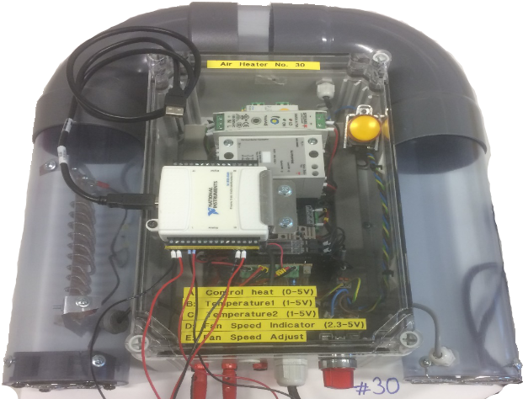
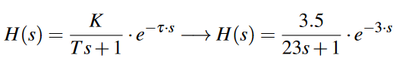
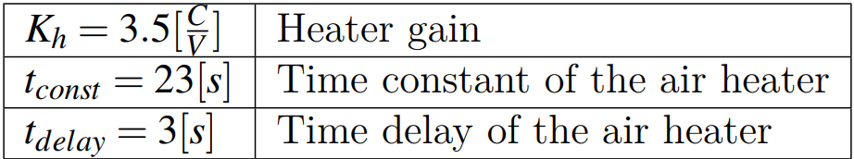
Air Heater Model
First-principle, transfer function, and state space models
$$T_{CONST}∙ der\left(T_{Out}\right)= \left(T_{amb}− T_{Out}\right)+ Kh∙ delay(u, 3)$$
Notes:
Air heater model - Time constant with time delay process dynamics
FIRST-PRINCIPLE
Implemented as a model in Modelica based on first-principle / mechanicstic model
Equation based
TRANSFERFUNCTION
Basic Modelica blocks
Time delay
Transfer function
STATE SPACE
Implemented with the use of SciPy Python package
Build transferfunction, then use series function to merge transfer and timedelay (padé)
All models simulated in same model, with same changes in setpoint

Slide 8
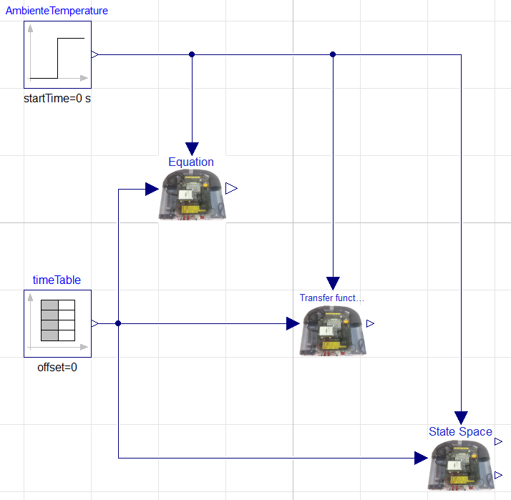
Air Heater Model
Simulation of first-principle, transfer function, and state space models
Notes:
Air heater model - Time constant with time delay process dynamics
FIRST-PRINCIPLE
Implemented as a model in Modelica based on first-principle / mechanicstic model
Equation based
TRANSFERFUNCTION
Basic Modelica blocks
Time delay
Transfer function
STATE SPACE
Implemented with the use of SciPy Python package
Build transferfunction, then use series function to merge transfer and timedelay (padé)
All models simulated in same model, with same changes in setpoint

Slide 9
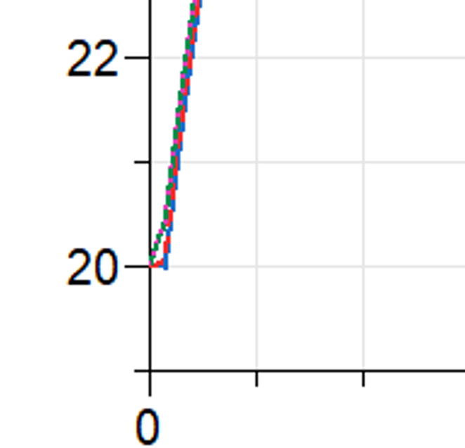
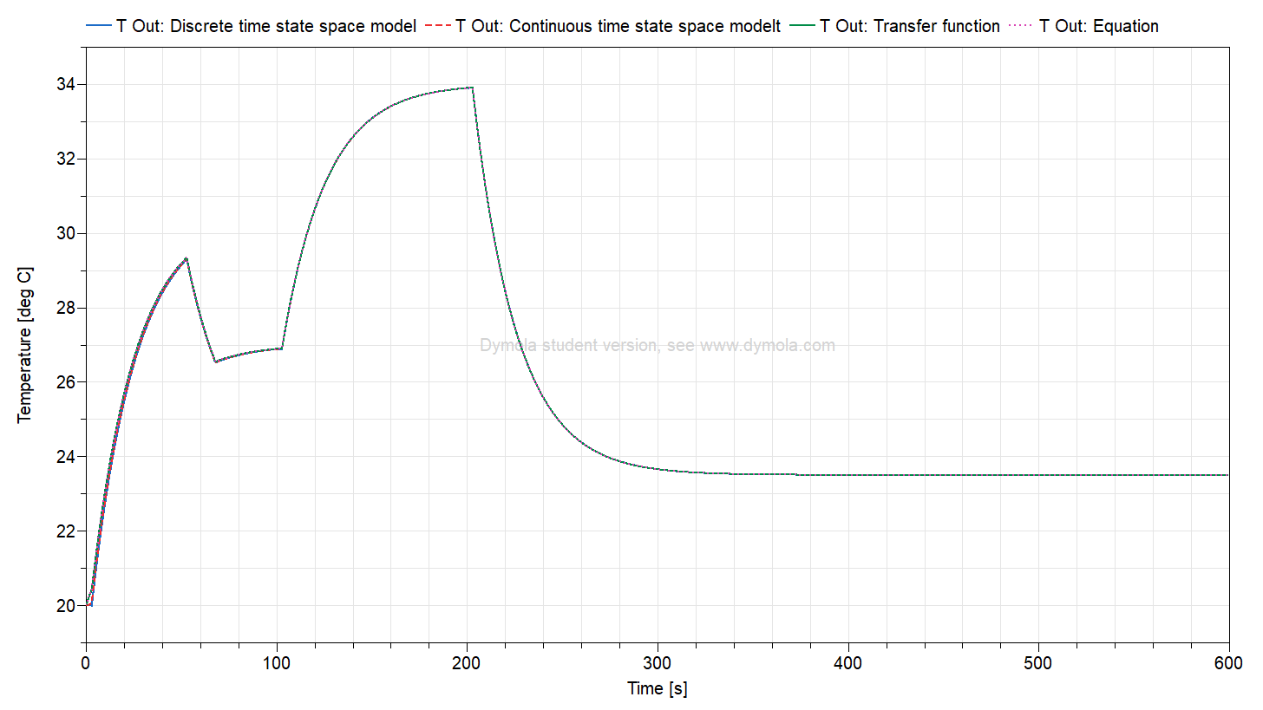
Air Heater Model
Results of first-principle, transfer function, and state space models

Slide 10
Calling External C Code in Modelica
Overview
Modelica Function
Modelica External Object
Basic functions with one return variable
Needs a Modelica block or model as a wrapper
Extended functionality and complexity
Enables reading and writing of variables from external memory across C and Modelica

Slide 11
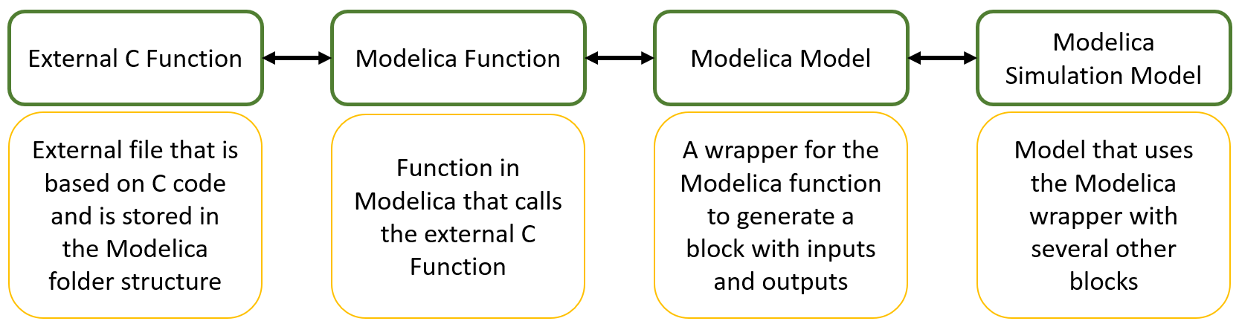
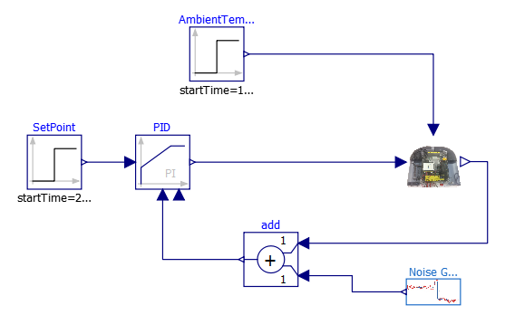
Calling External C Code in Modelica
Based on Modelica function

Slide 12
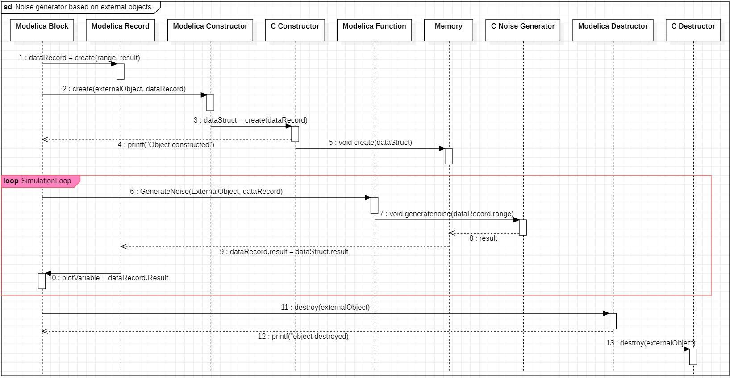
Calling External C Code in Modelica
Based on use of external objects
Notes:
Error: C Destructor writes object destroyed to the screen

Slide 13
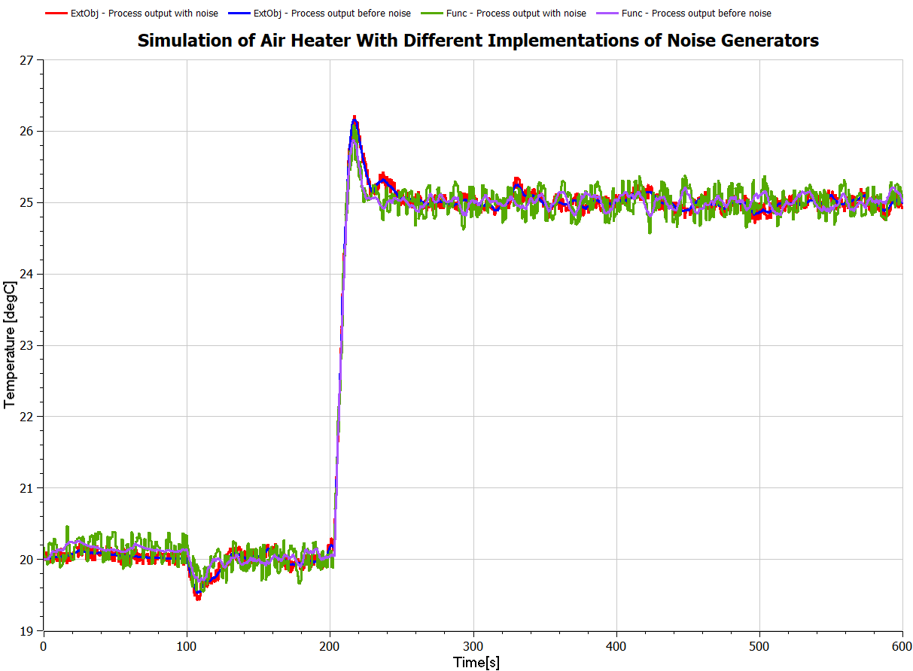
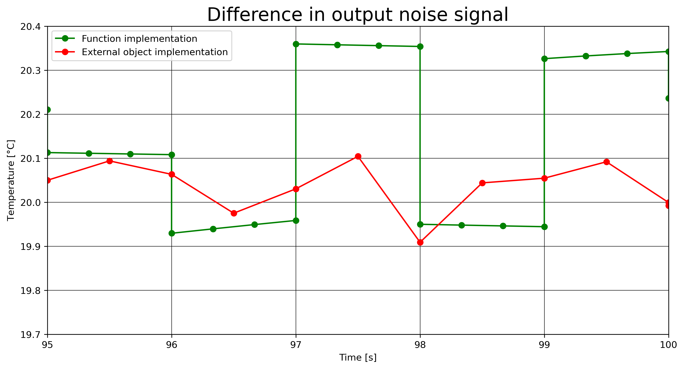
Calling External C Code in Modelica
Results

Slide 14
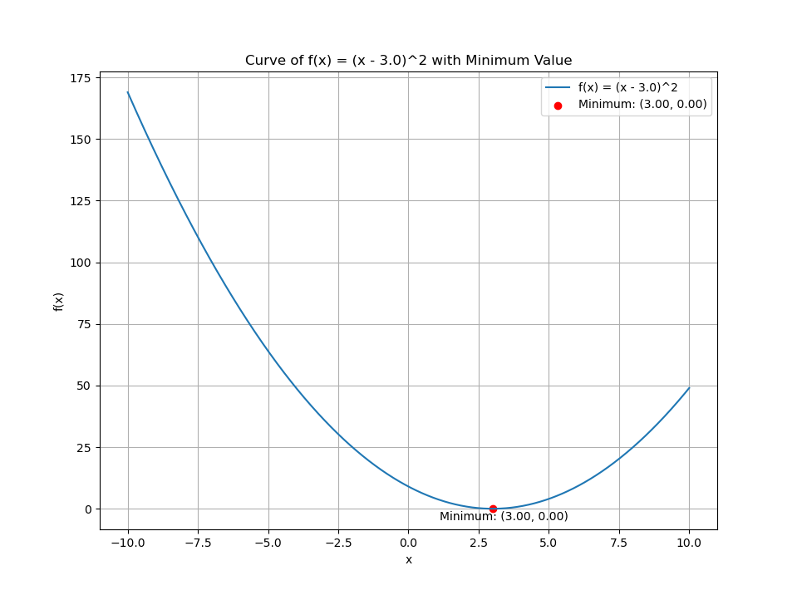
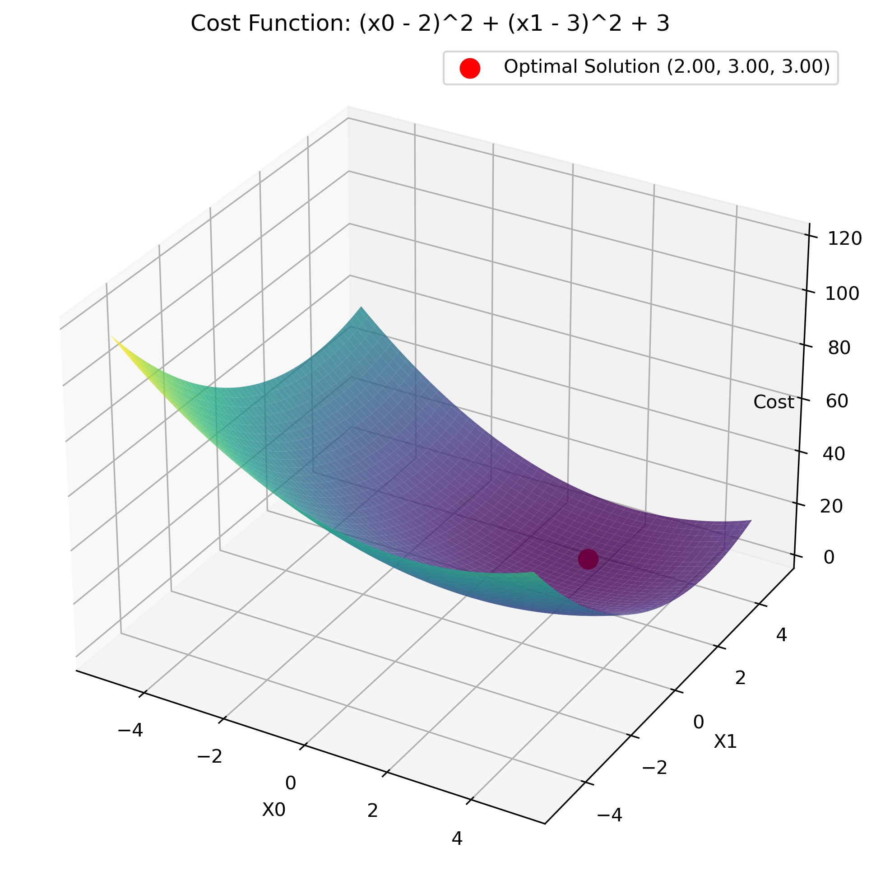
NLopt
Overview
Basic example for calling external C functions in NLopt from OpenModelica and returning values to OpenModelica
Examples of solving a univariate optimization problem in OpenModelica by calling a NLopt function in C
Examples of solving a multivariate optimization problem in OpenModelica by calling a NLopt function in C
NLopt
Version

Slide 15
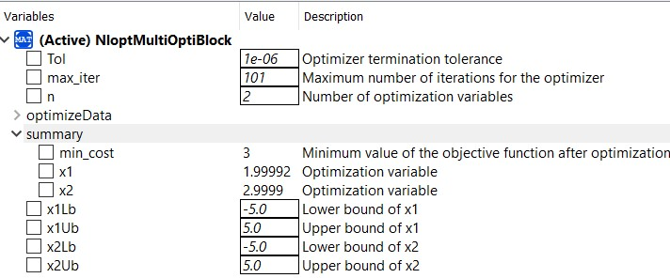
NLopt
Multivariate optimization
$$f(x) = {\left(x_{0}− 2\right)}^{2} + {\left(x_{1} − 3\right)}^{2} + 3$$

Slide 16
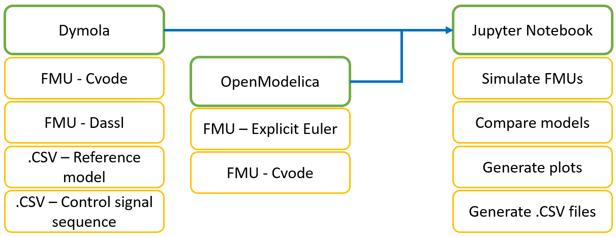
FMU of Air Heater in Python

Slide 17
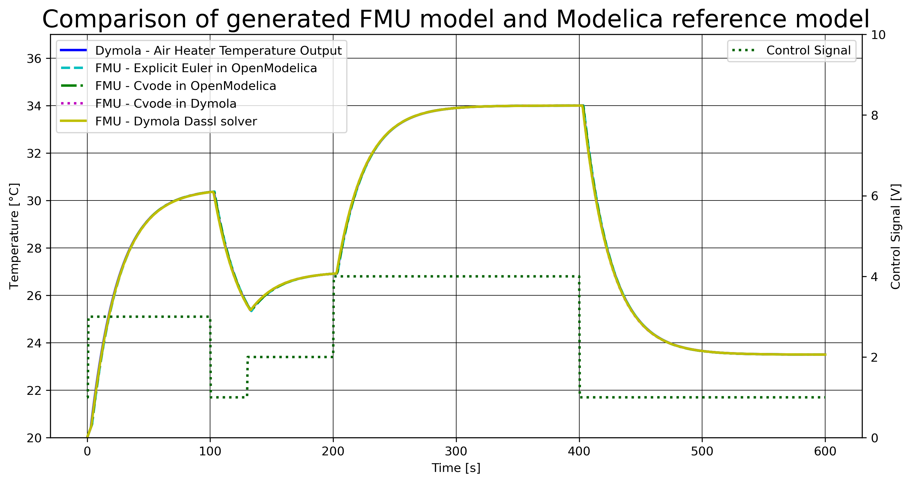
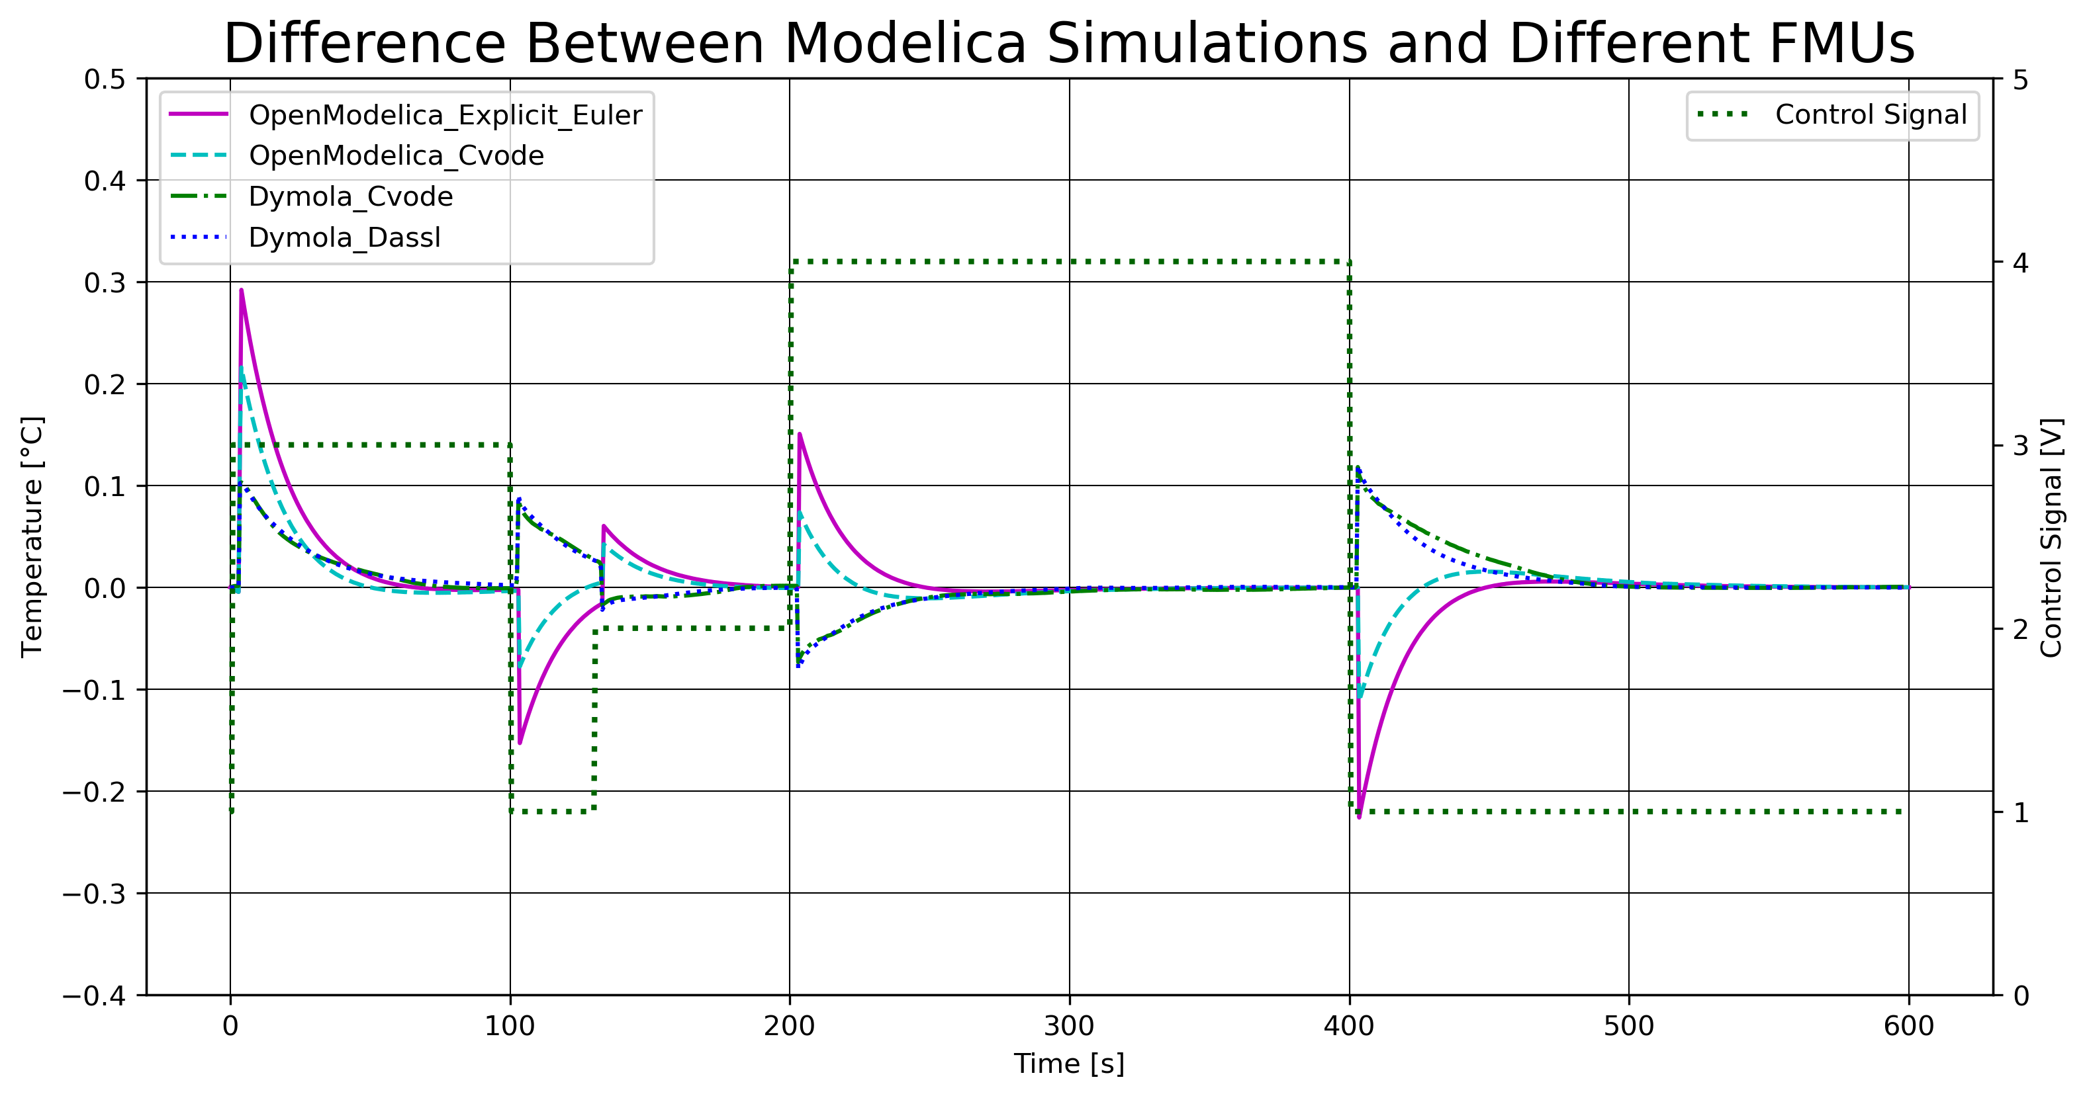
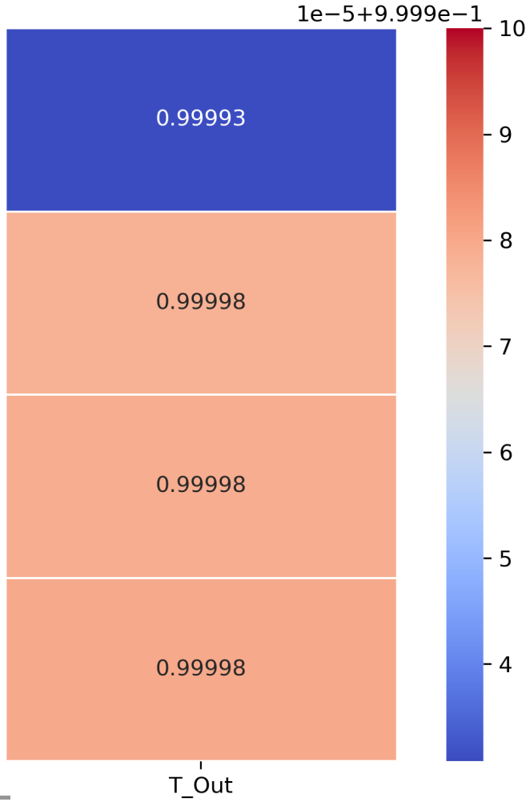
FMU of Air Heater in Python

Slide 18
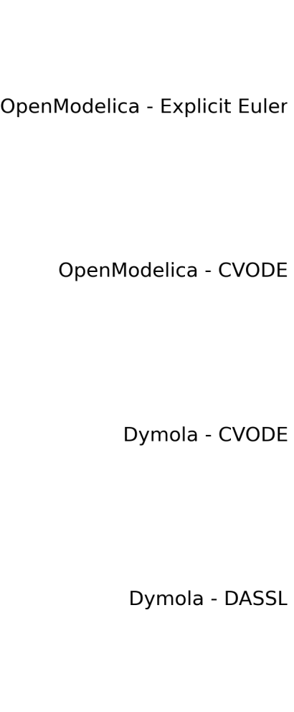

Slide 19
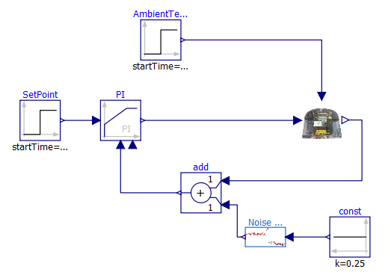
FMU of Air Heater with PI-controller in Python

Slide 20
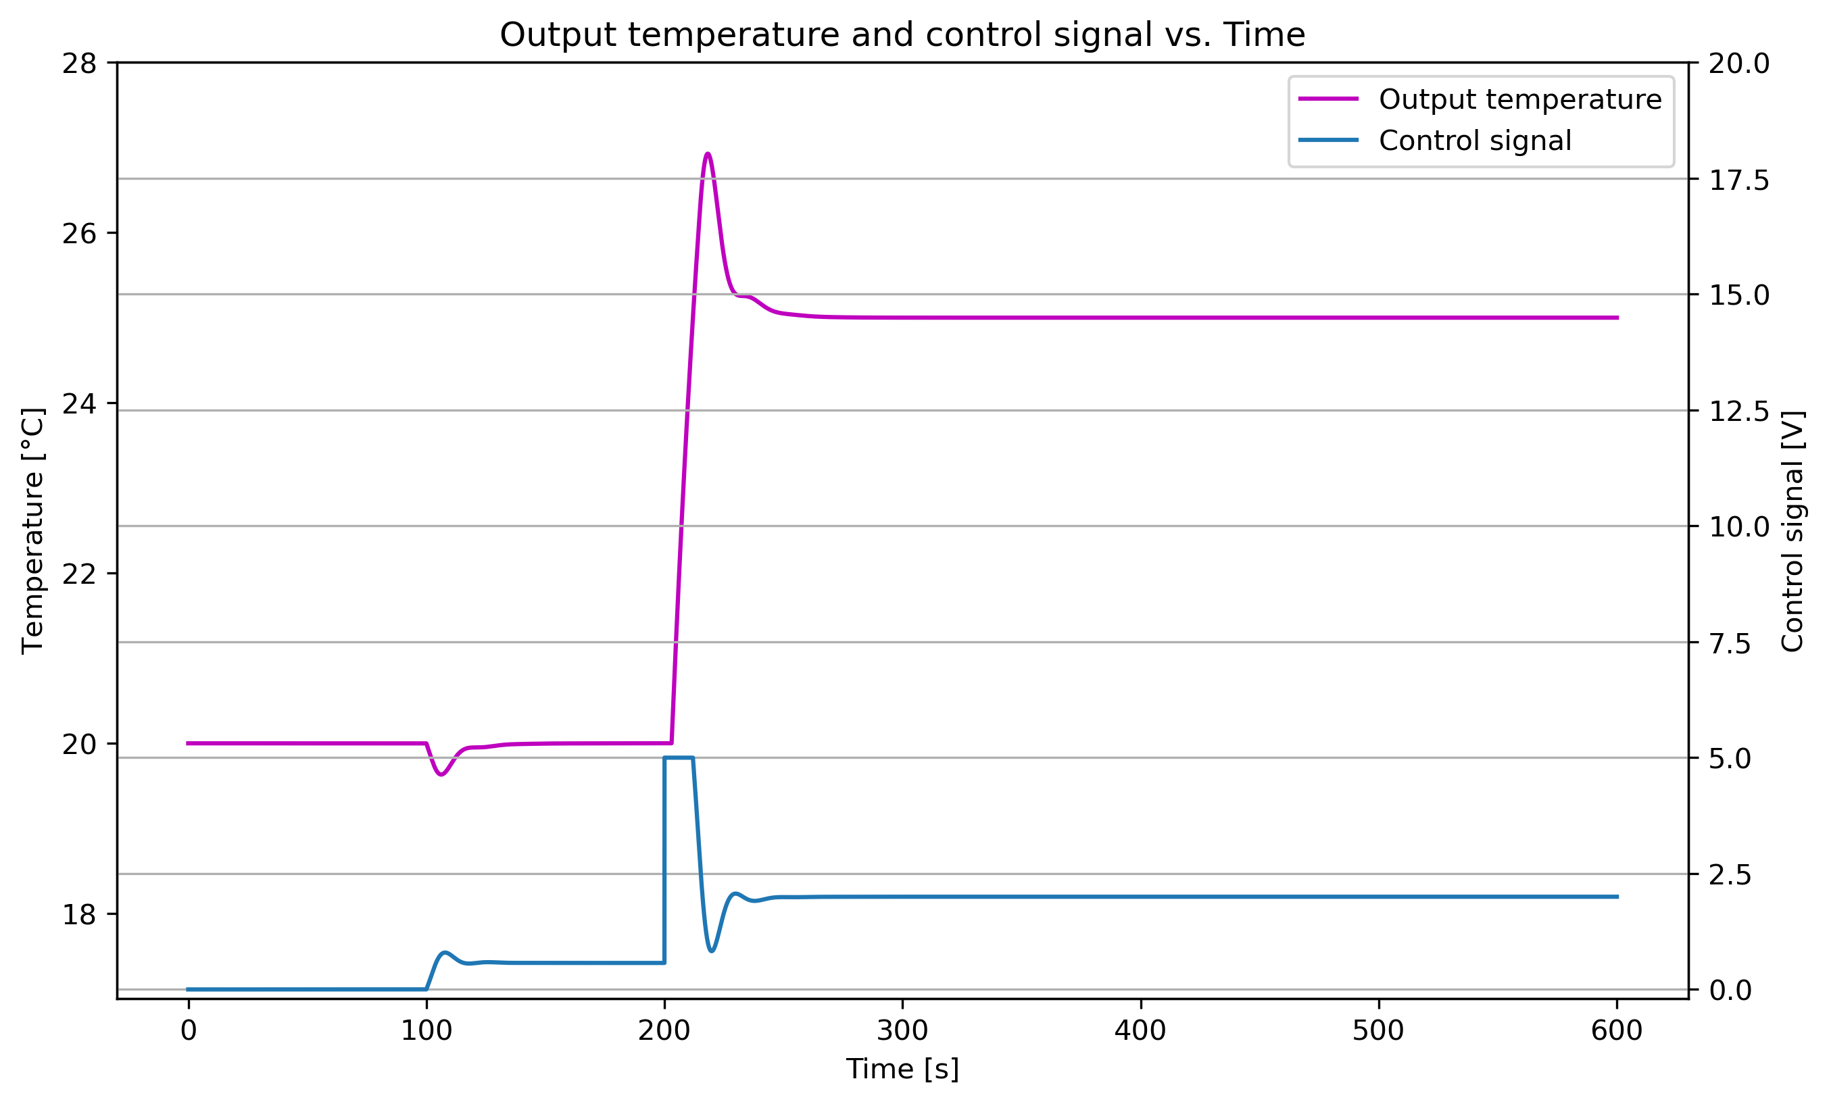
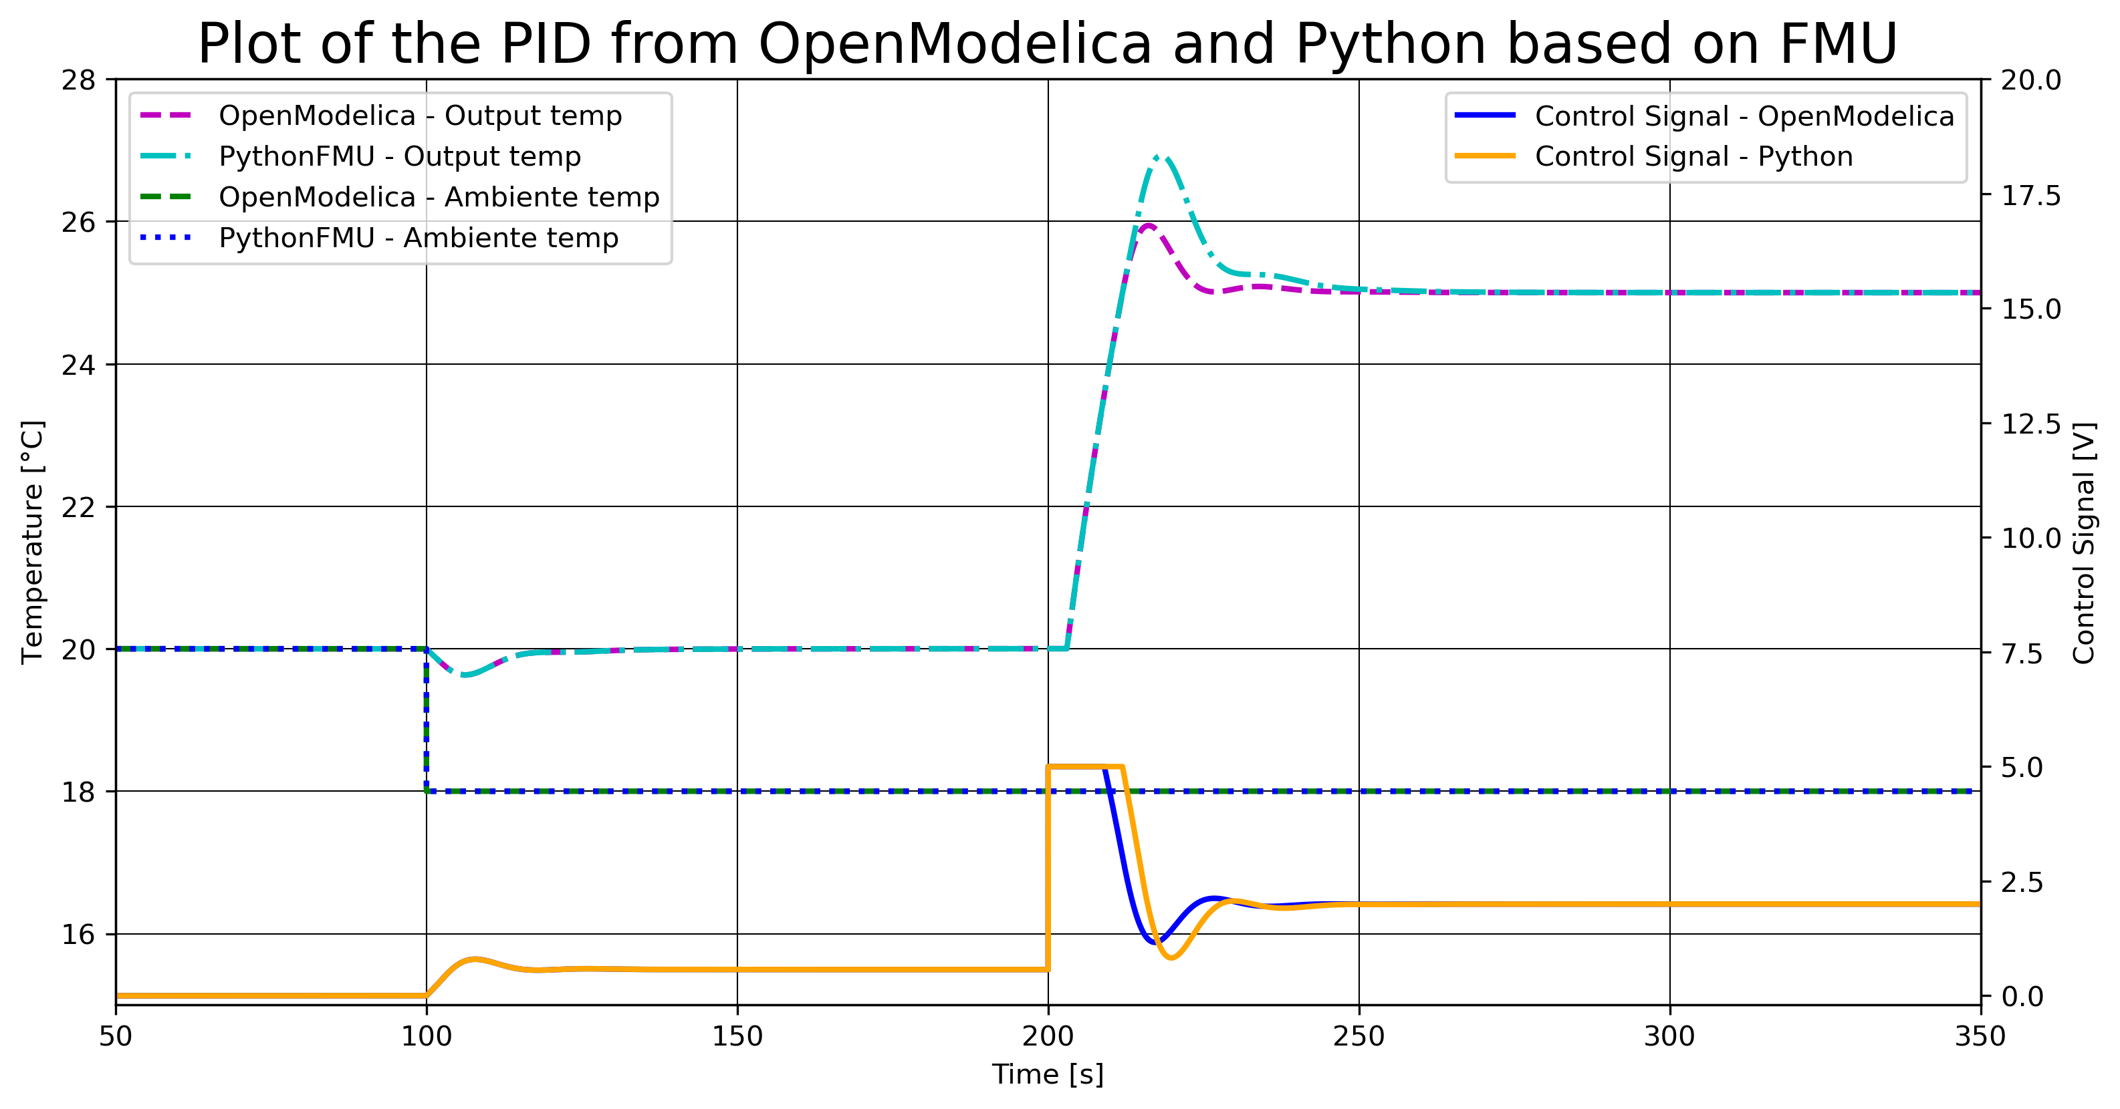
FMU of Air Heater with PI-controller in Python

Slide 21
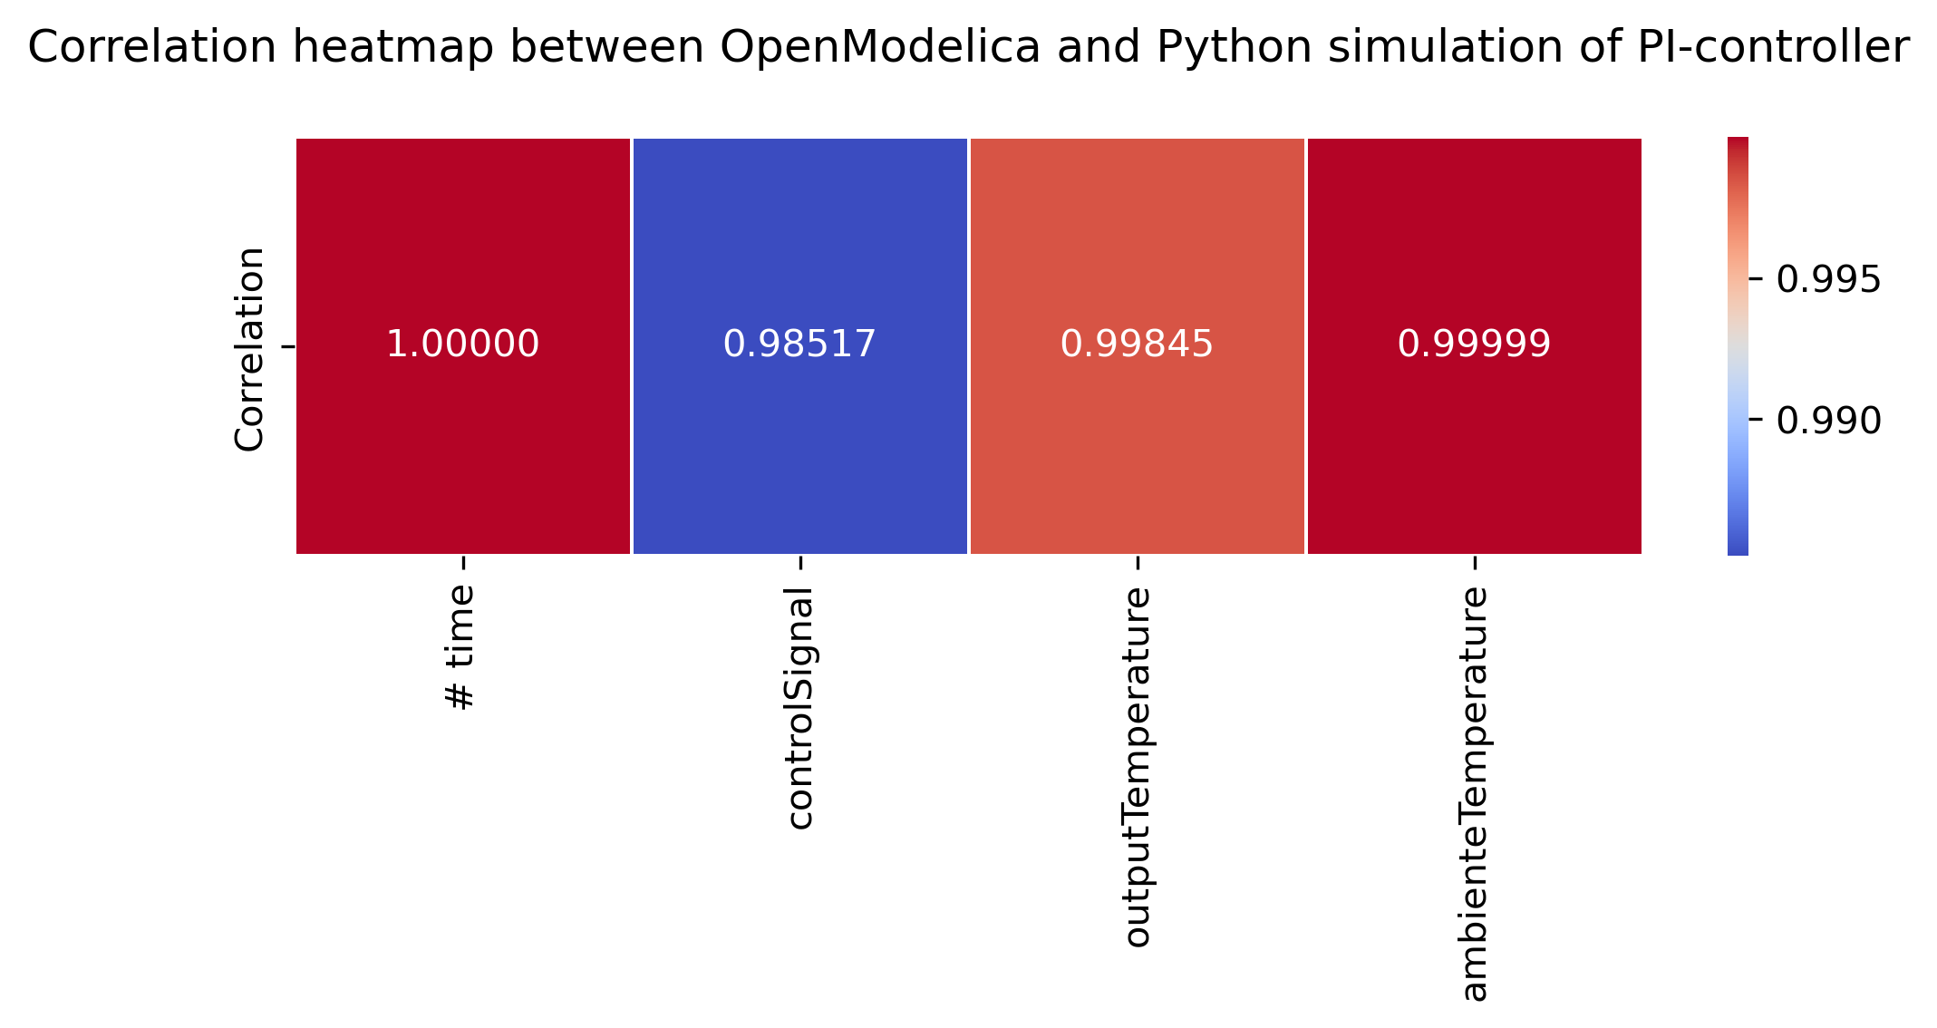
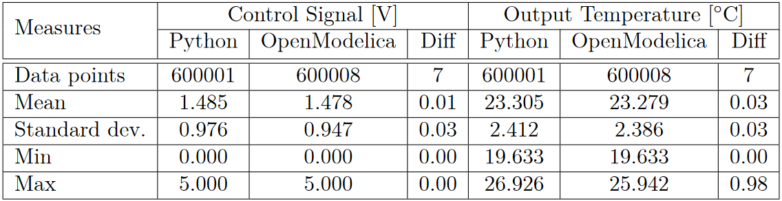
FMU of Air Heater with PI-controller in Python

Slide 22
FMU of Air Heater with MPC in Python

Slide 23
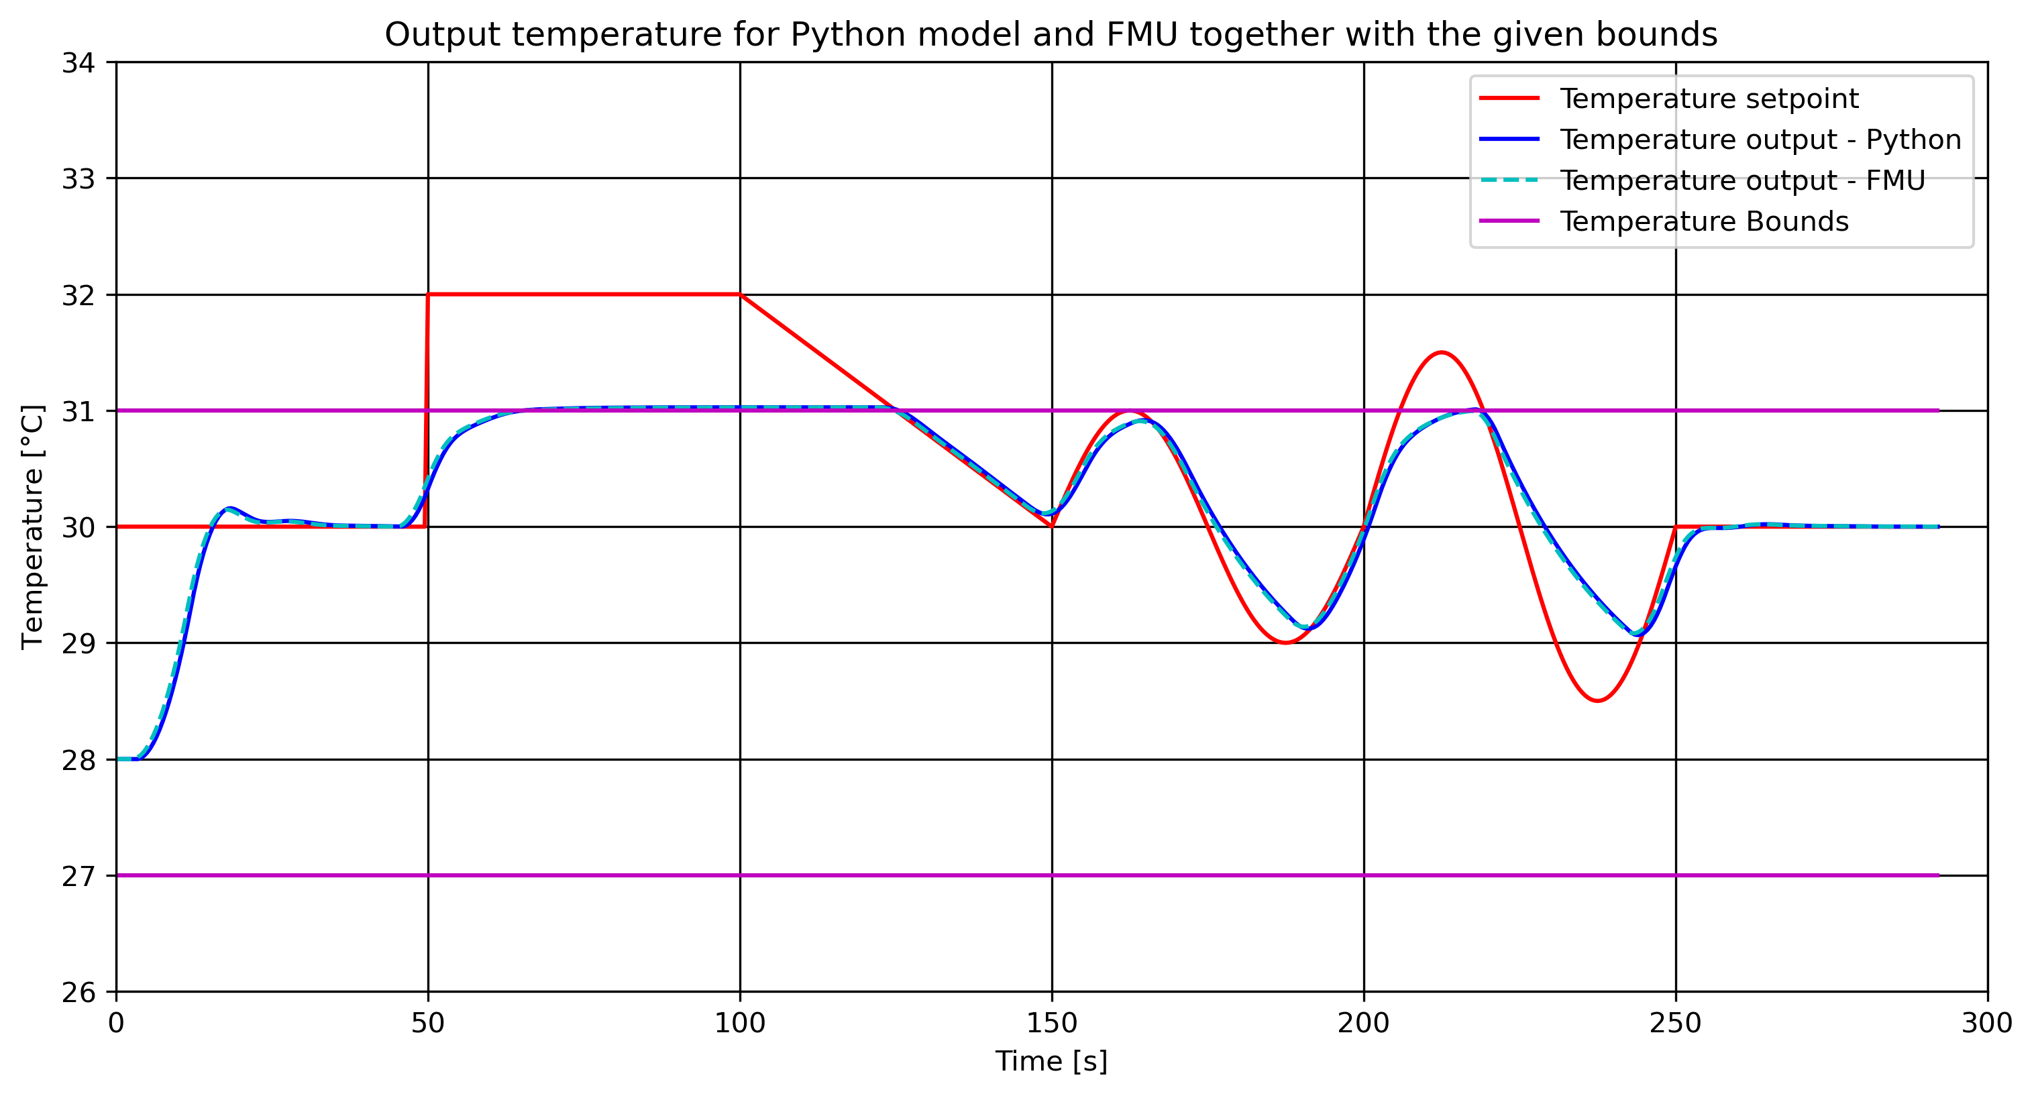
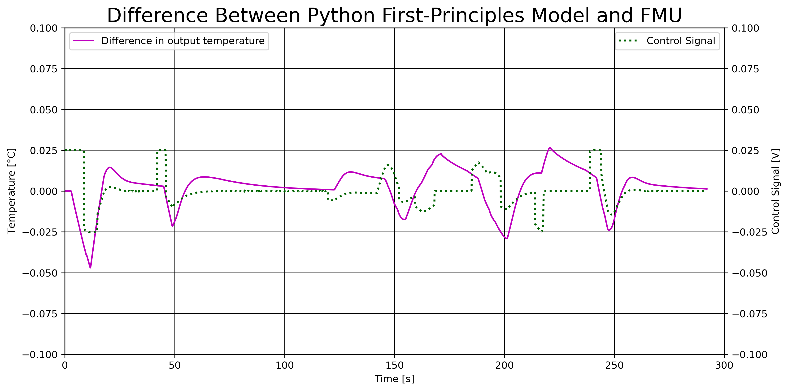
FMU of Air Heater with MPC in Python

Slide 24
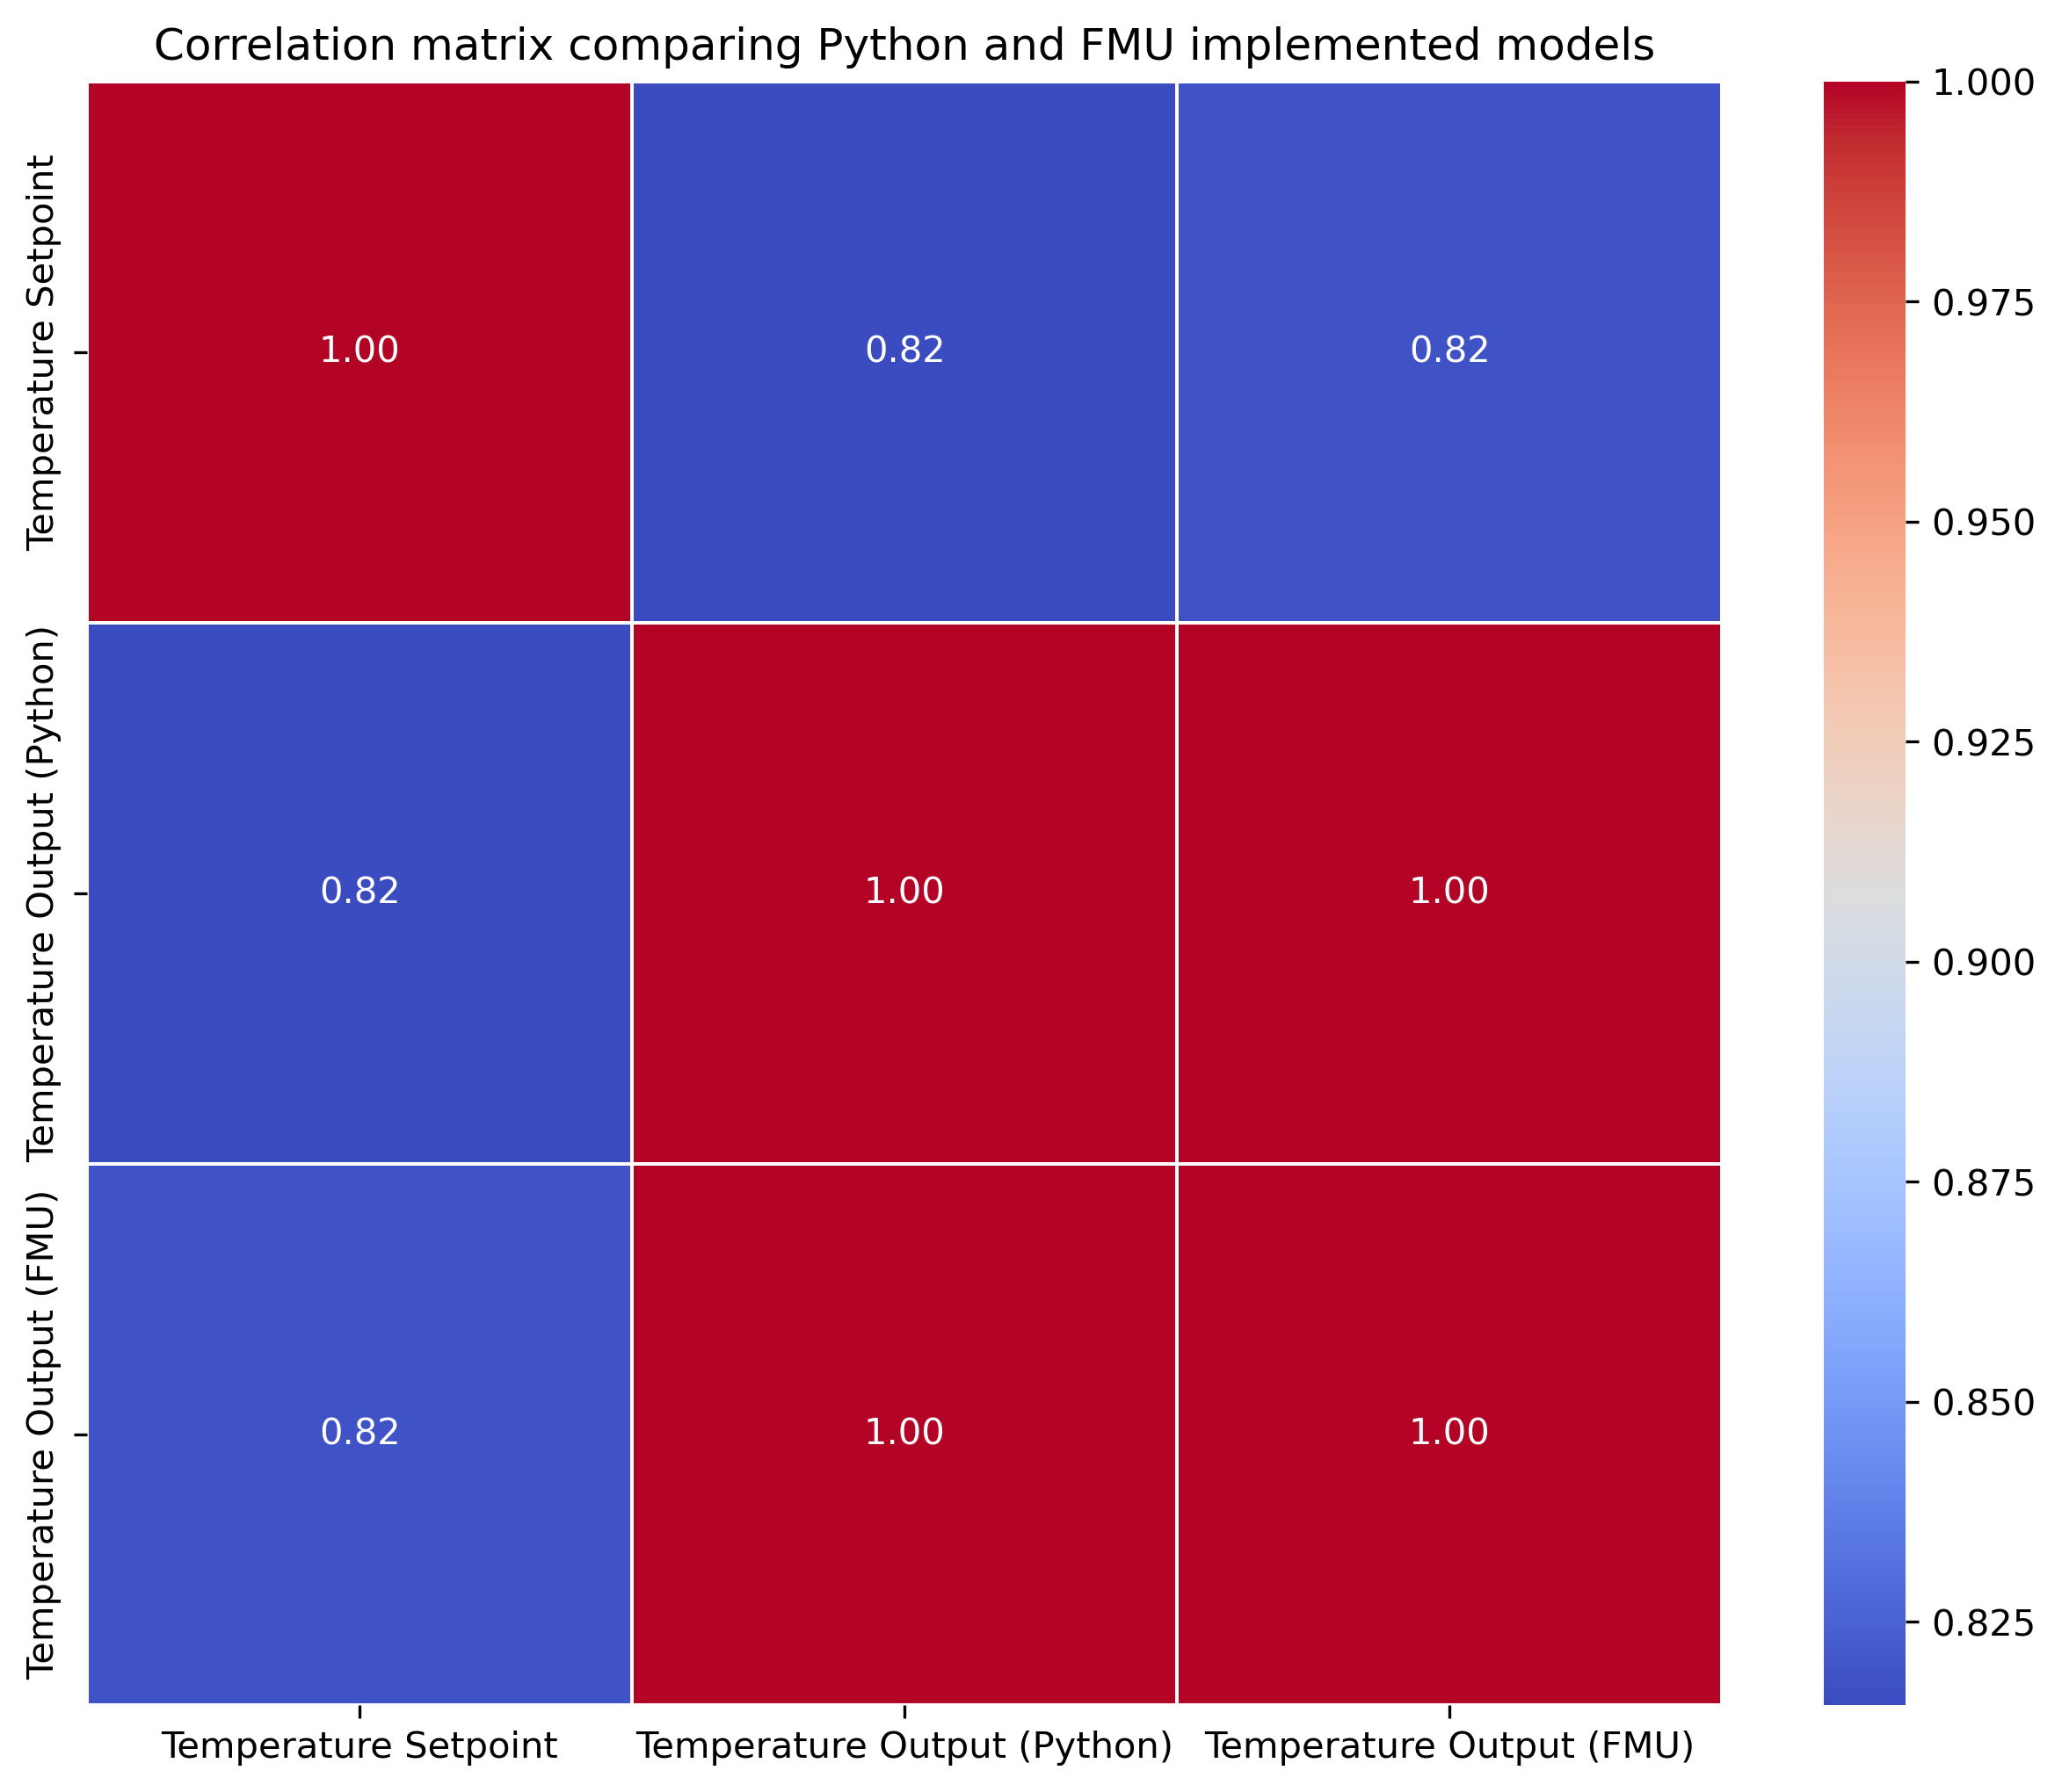
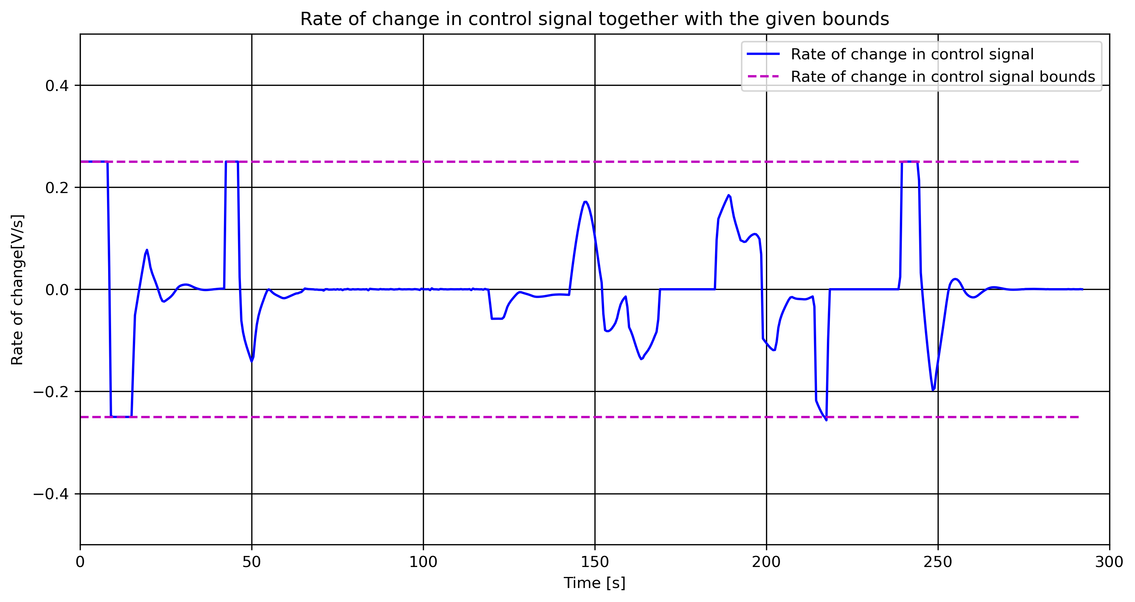
FMU of Air Heater with MPC in Python

Slide 25
Conclusion

Slide 26
Future Work

Slide 27
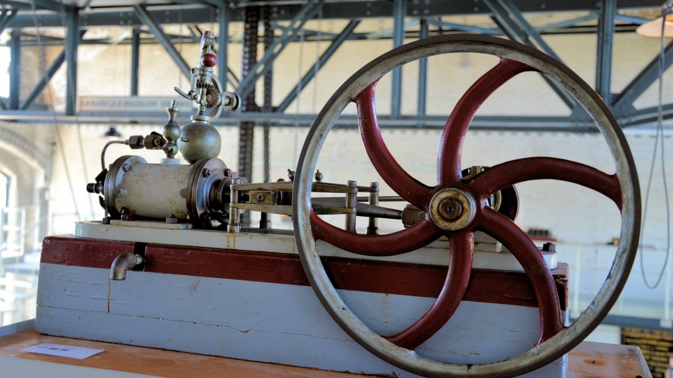
Thank you for the attention

Slide 28
DRAFTS

Slide 29
Existing Options
JModelica
Discontinued in 2019
Three packages moved to GitHub:
Assimulo
Python simulation packages
PyFMI
Load and simulate FMUs
FMI Library
C package to load and simulate FMUs

Slide 30
Existing Options
FMPy - Dassault Systèmes
Free Python library
Graphical user interface
Validate FMUs
Export to Jupyter Notebook, Modelica and Cmake
Read model data
Web App to share FMUs with anyone in a browser

Slide 31
Existing Options
NLopt
Open-source library
C, C++, MATLAB, Fortran, Python among others
Collection of several algorithms from different contributors
Set up the Optimizer Object
Set up Objective Function
Set Bounds
Optimize the Problem!
Define optimizer algorithm and number of optimization variables
Combine the optimizer object and the function to be optimized
Set upper, lower, equality and inequality bounds based on algorithm capability
Use the optimizer together with the defined minimum cost and the optimization variable

Slide 32
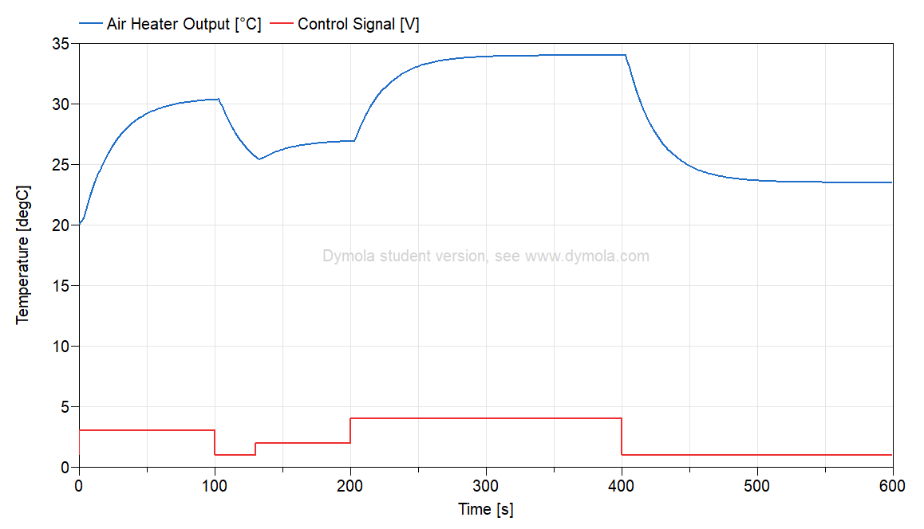
Air Heater Model
First-principles model in Modelica
$$T_{CONST}∙ der\left(T_{Out}\right)= \left(T_{amb}− T_{Out}\right)+ Kh∙ delay(u, 3)$$
Notes:
Air heater model - Time constant with time delay process dynamics
Implemented as a model in Modelica

Slide 33
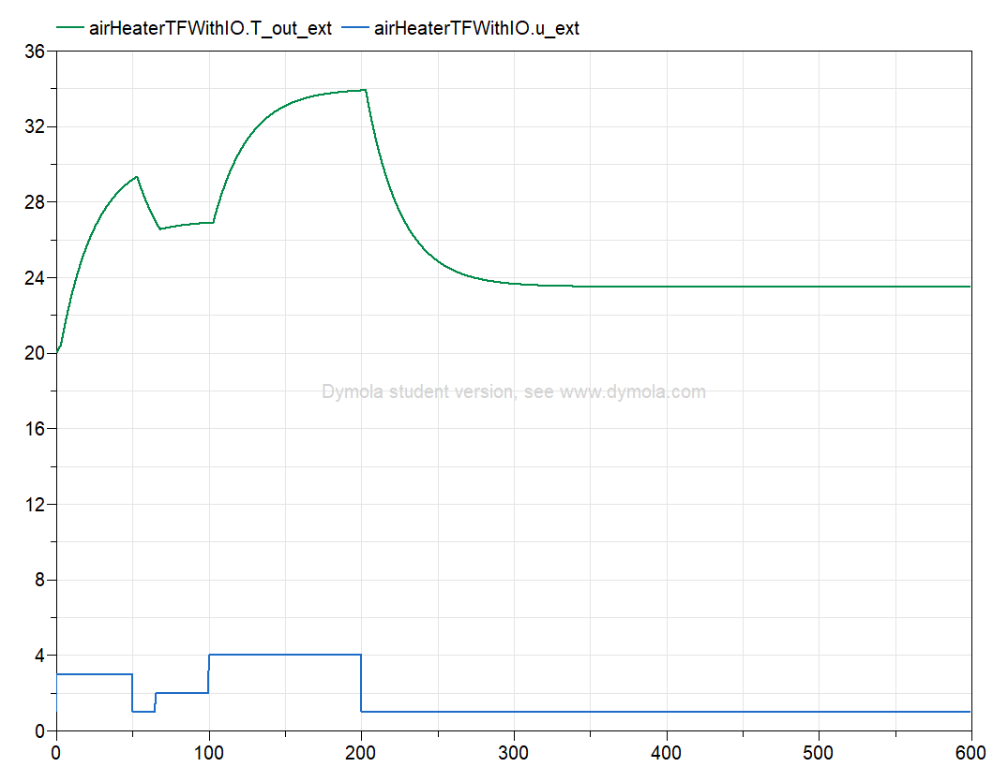
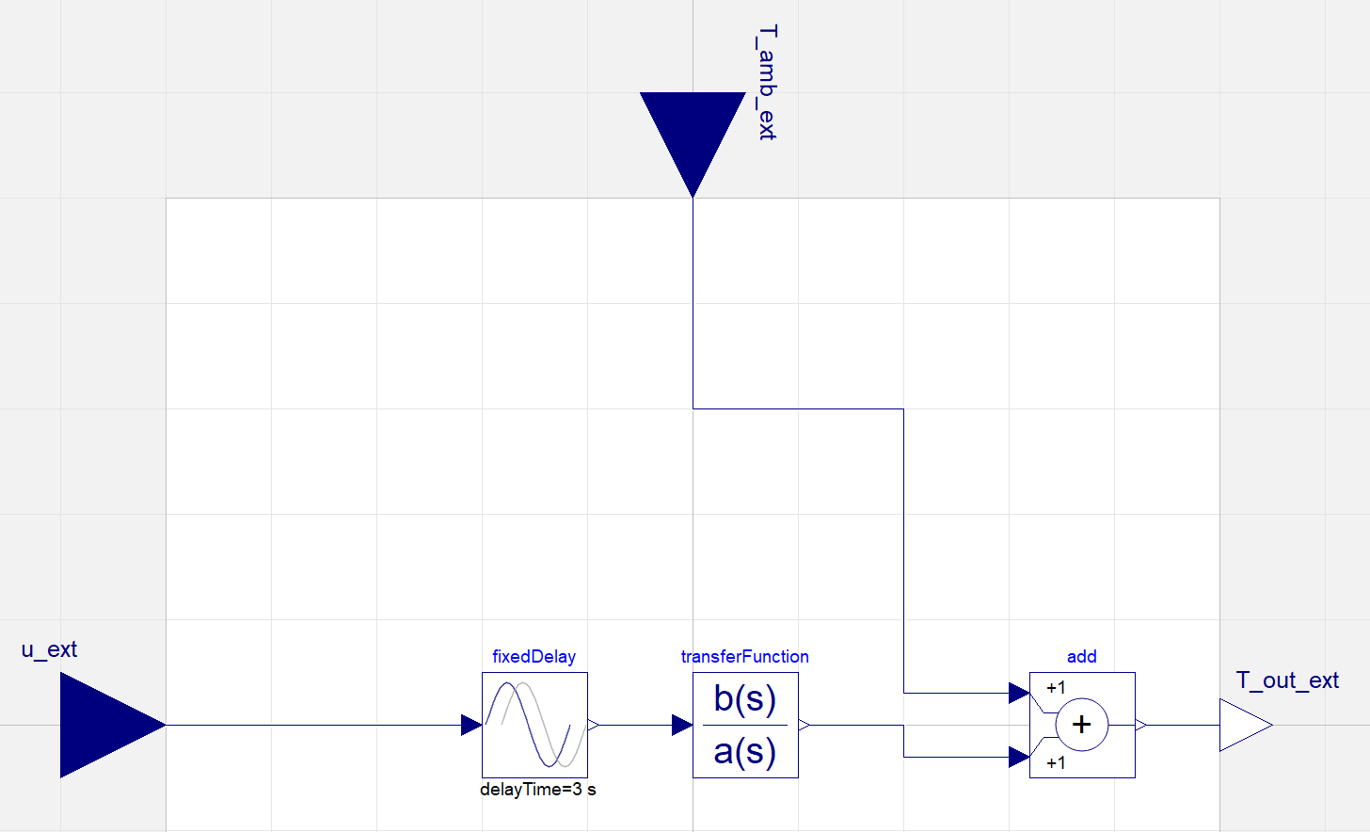
Air Heater Model
Transfer function

Slide 34
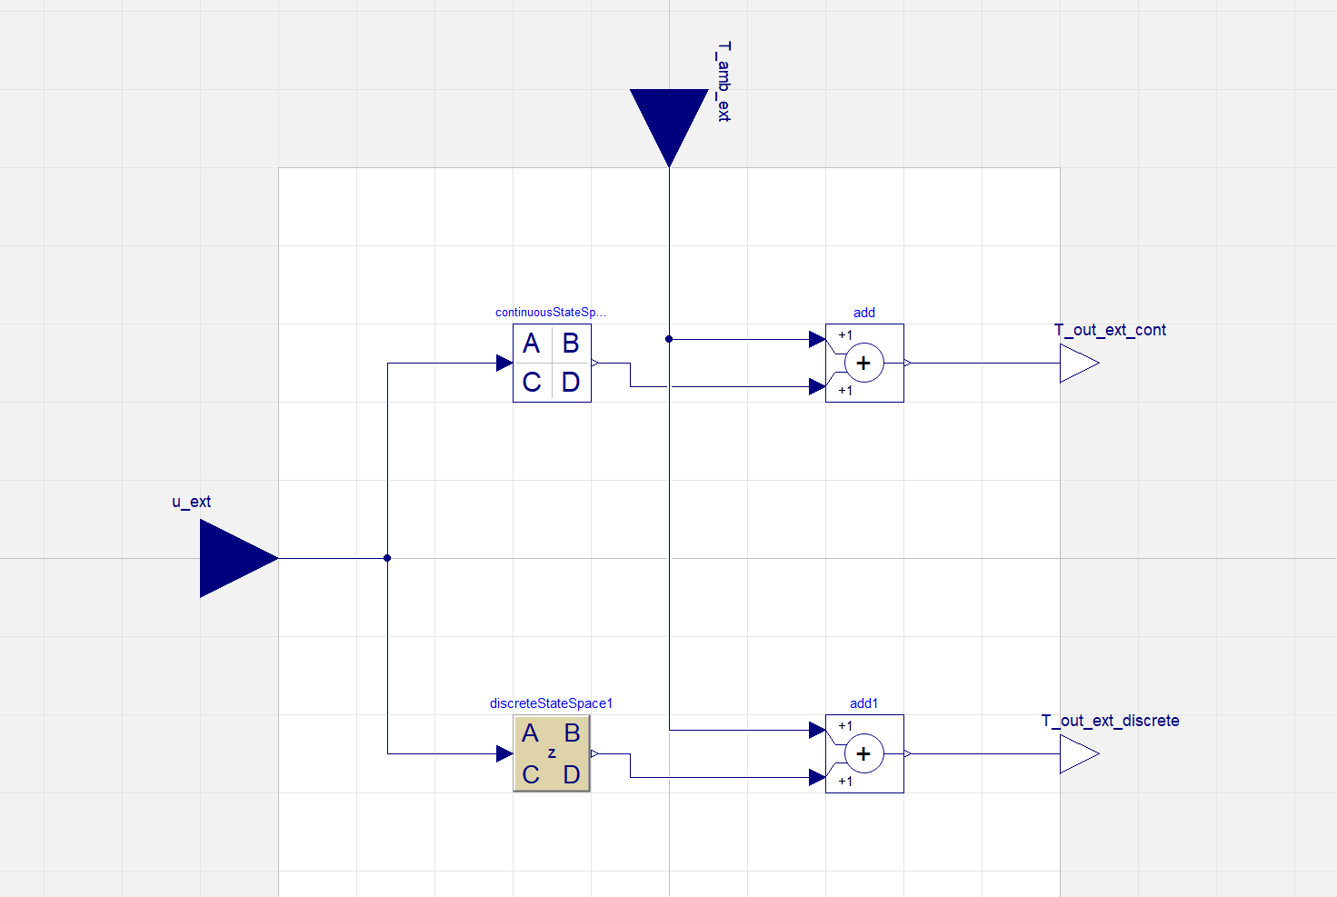
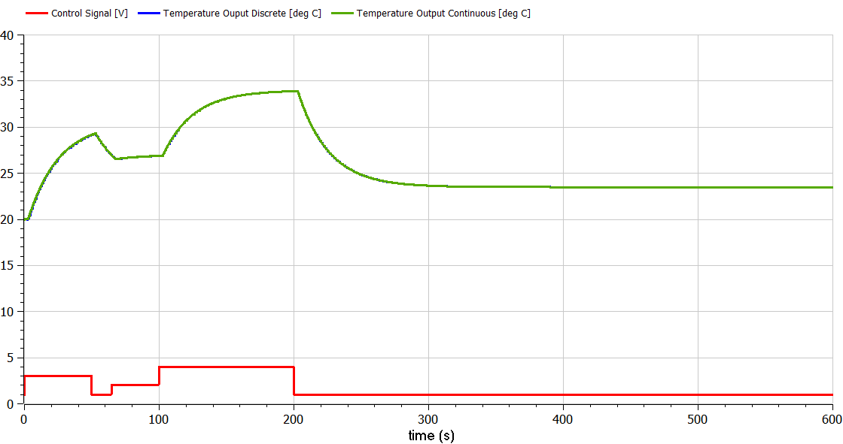
Air Heater Model
State space models

Slide 35
Air Heater Model
Model evaluation

